Slide 1

ASAPIO - Implementation

Slide 2
AIF Implementation
Maintenance of RFC Destination
Test & Monitoring

Slide 3
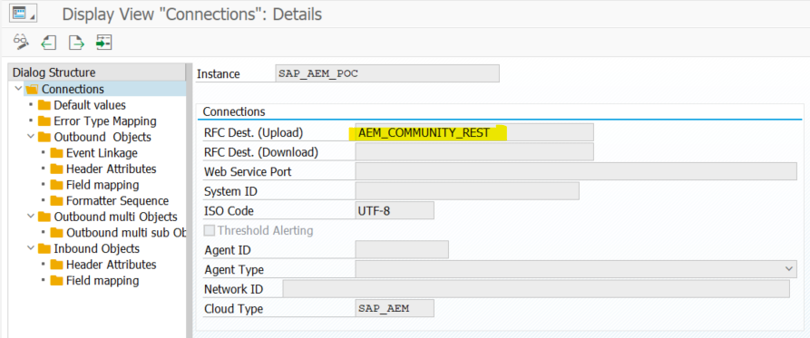
Maintenance of RFC Destination
Go to transaction SPRO >IMG >Asapio Integration Add-On >Connection and Replication Object Customizing.
Double-click on Instance SAP_AEM_POC and replace RFC-Destination “ACI_SOLACE_DEMO_SCOTT” with the RFC Destination you have prepared in the Prerequisites

Slide 4
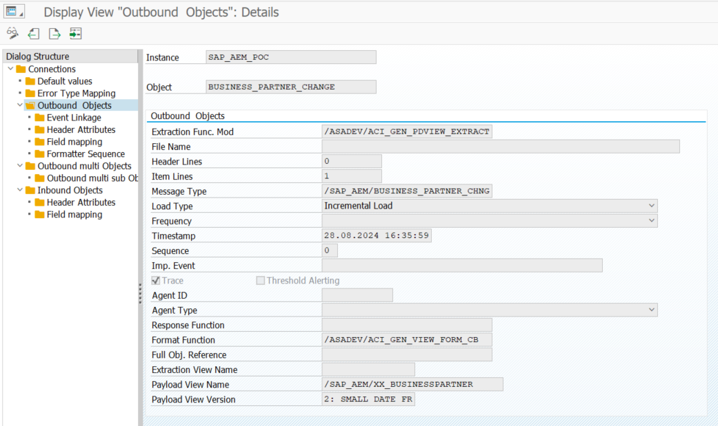
2. Configuration
The Rest of the configuration is preconfigured and was part of the content package. Example: BUSINESS_PARTNER_CHANGE in Outbound Objects

Slide 5
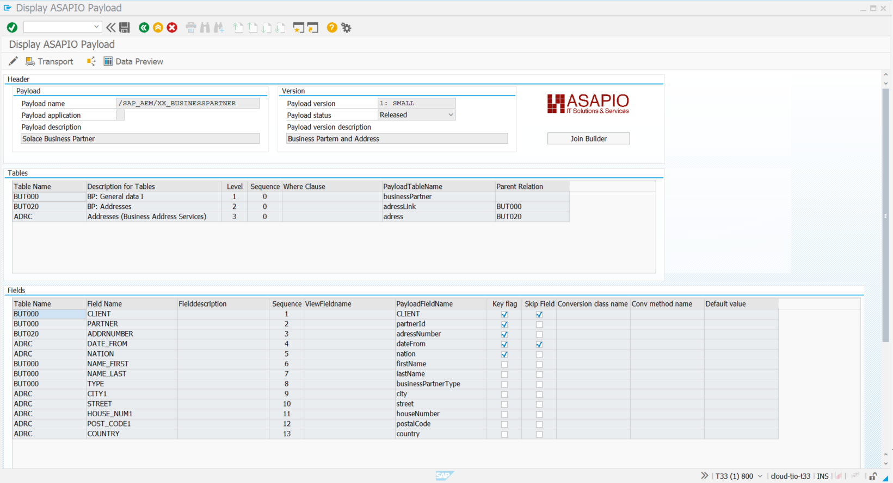
2. Configuration
Double Click on Payload View Name + Double-Click on Version ->

Slide 6
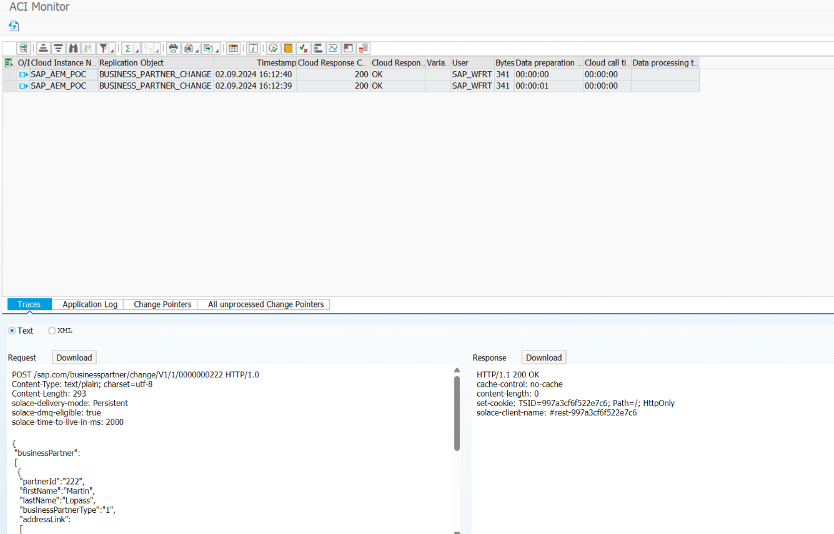
2. Test & Monitoring - Traces
Tcode: /n/ASADEV/ACI_MONITOR

